Slide 1

NIDDK DIABETES ANALYSIS CAPSTONE PROJECT SCREENSHOTS

Slide 2
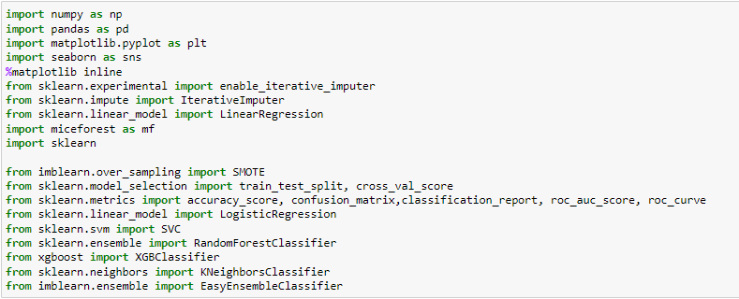
Import the required Libraries

Slide 3

Loading the csv file into a DataFrame (df)
Replace 0 with null values
Plot histogram plot for different columns

Slide 4

Imputing Null values using Iterative imputer and validating it using kde plots

Slide 5
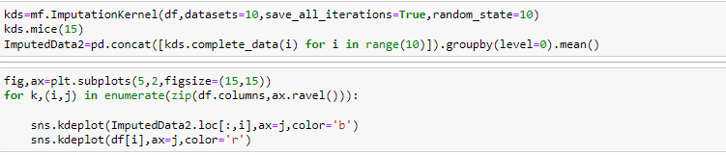
Imputing Null values using Mice forest and validating it using kde plots

Slide 6
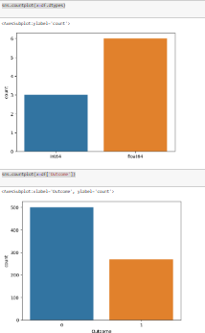
Countplot of datatypes, outcomes

Slide 7
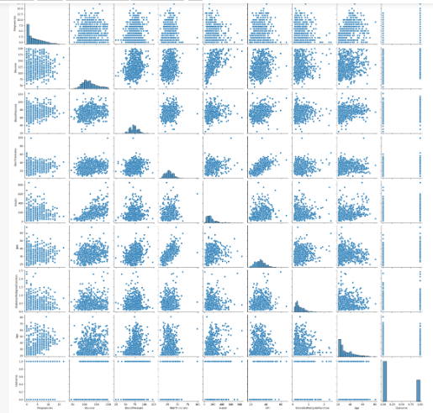
Pairplot to check correlation

Slide 8
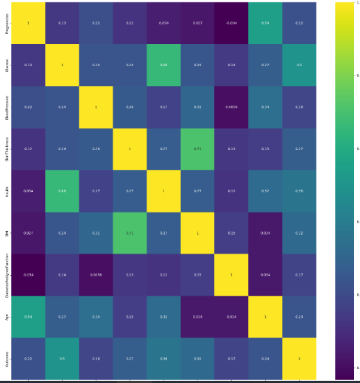
HeatMap

Slide 9
Upsampling Using Smote

Slide 10
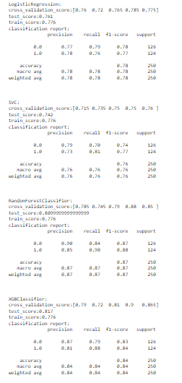
Printing Classsification reports using multiple models

Slide 11
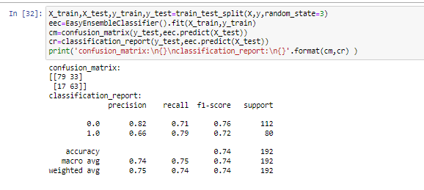
Classification Report using Easy Enssemble Classifier

Slide 12
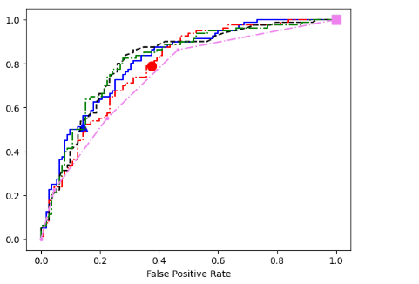
ROC-AUC Curve

Slide 13
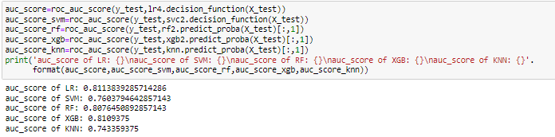
AUC Score

